Slide 1
MRA Project Part B
User name: Rajesh MAmbulli
batch: PGPDSBA.O.SEP24.A
Email: rajeshmambulli@icloud.com

Slide 2
Agenda – Part B: Market Basket Analysis Using Association Rules
Business Context: Overview of the grocery retail environment and need for basket-level insights
Problem Statement & Objectives Define the analytical challenge and goals—identifying item combinations to enhance sales
Data Understanding Structure and features of POS transactional data
Methodology Approach for preprocessing, transaction grouping, and rule mining
Rule Mining Results Presentation of top frequent item sets and association rules with support, confidence, and lift
Insights from Item Combinations Interpretation of results—product affinities, complementary items, and strategic pairing
Marketing Strategy Recommendations Suggested combo offers, discount strategies, and placement tactics based on insights
KNIME Workflow Snapshot Overview of the workflow used for mining and visualization
Conclusion & Business Impact Summary of findings and how they support profitability, loyalty, and operational efficiency

Slide 3
Business Overview
In the highly competitive grocery retail industry, understanding customer buying patterns is crucial for enhancing sales, increasing customer satisfaction, and improving profitability. By identifying frequently purchased item combinations, grocery stores can craft effective marketing strategies, optimize inventory management, and tailor promotions to meet customer needs. Leveraging Point of Sale (POS) data can unlock valuable insights that drive customer-centric offerings, such as combo packs, discounts, and targeted promotions, which can increase basket size and improve customer retention. This analysis aligns with business goals by maximizing revenue, reducing operational costs, and boosting customer loyalty.

Slide 4
Problem Statement
Objective:
As a business analyst, the goal is to analyze the POS transactional data to identify frequently purchased item combinations. Using association rule mining or similar techniques, the aim is to uncover patterns that will help the store create targeted combo offers and discounts, ultimately driving revenue growth by increasing customer purchases and average basket size.

Slide 5
Data Description
The dataset provided contains three years of transactional data from the company, with each row representing a unique order. Below is an explanation of the key attributes:
Date: The date when the transaction took place.
Order_id: A unique identifier for each customer order.
Product: The individual item purchased in the transaction.

Slide 6
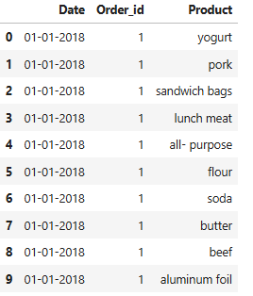
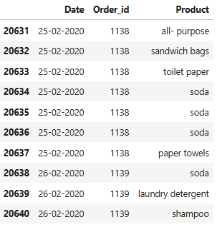
EDA STARTS
This is Head and Tail of the provided Sales Data

Slide 7

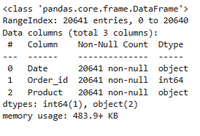
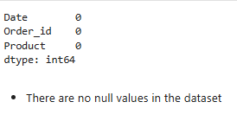
EDA cont..
All the Datatypes are correct no intervention is required.
Duplicates in the data, which need to be grouped
No Missing values in the data

Slide 8
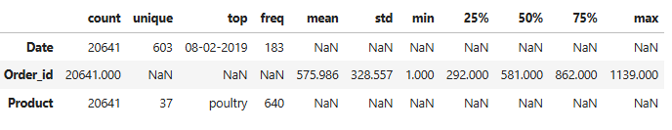
EDA cont..
Dataset Size:
A total of 20,641 product-level transactions across 603 unique dates provides a substantial and well-spread foundation for basket analysis.
Order-Level Insights
There are approximately 1,139 unique orders, with a fairly even distribution:
Median Order ID: 581,
25% of orders below 292, and
Top quartile above 862.
This range reflects a healthy mix of new and returning customers over time.
Temporal Demand Pattern
The most active day is 08-02-2019, with 183 items sold—suggesting a spike worth further investigation (campaign, promotion, seasonality?).
Product Popularity
37 unique products are sold, with poultry being the most frequent, appearing 640 times—making it a strong candidate for combo deals or feature placement in promotions.

Slide 9
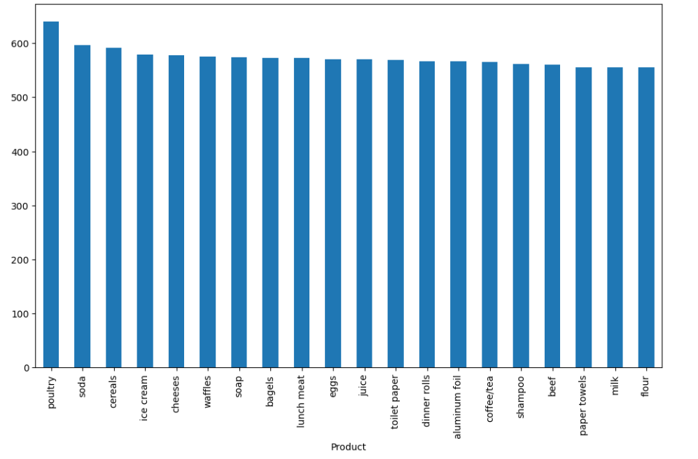
EDA cont..
Top-Selling Item: Poultry leads significantly with over 640 units sold, establishing it as the most frequently purchased product—an excellent candidate for promotional combos or feature placement.
High-Demand Staples: Products like soda, cereals, ice cream, cheeses, and waffles also show strong sales volumes (500–600 units), suggesting they form the core of recurring shopping baskets.
Diverse Basket Composition: A wide range of items—spanning breakfast (bagels, eggs), beverages (juice, coffee/tea), and hygiene (soap, toilet paper, shampoo)—indicates broad category engagement and cross-selling potential.
Marketing Opportunity: Frequent co-occurrence of staple goods and household items opens the door for multi-category combo deals (e.g., pairing beverages with breakfast items or hygiene products with pantry staples).

Slide 10
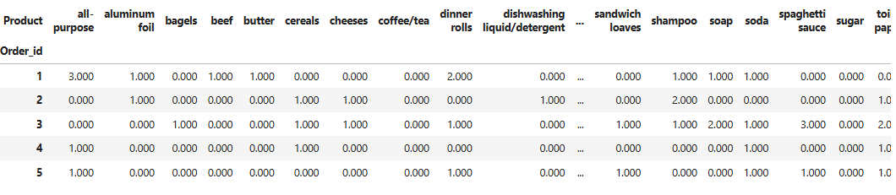
EDA cont..
Frequent Co-occurrences Across Orders
Core staples like bagels, beef, butter, shampoo, soap, soda, and toilet paper appear consistently across multiple orders, indicating they are commonly bundled.
Strong Pairing Candidates
Items such as dishwashing liquid, spaghetti sauce, sugar, and shampoo are often purchased together in orders with dinner rolls or all-purpose flour. These suggest natural household or pantry groupings for combo offers.
Core Convenience Items
Products like aluminum foil and coffee/tea tend to appear with a wide variety of other items, implying their versatility across baskets—ideal for promotional anchoring.
Cross-Category Basket Behavior
Presence of hygiene items (shampoo, soap) with grocery goods points to multi-category purchasing behavior, making them prime candidates for cross-category bundling (e.g., “meal & hygiene” kits).

Slide 11
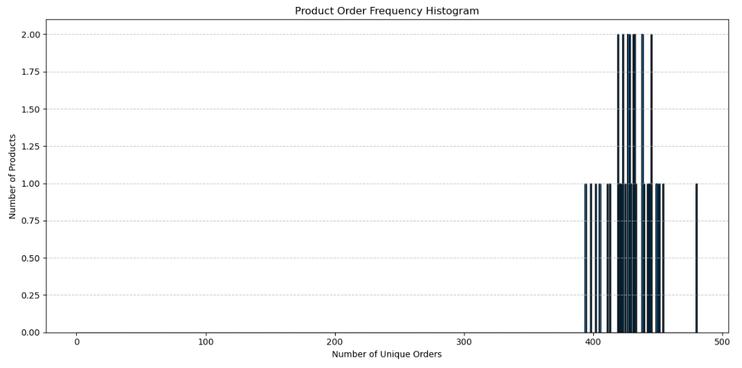
EDA cont..
High Frequency Core Products
Most products appear in 380 to 450 unique orders, suggesting a strong backbone of consistently purchased items.
Balanced Distribution
The histogram shows a relatively tight spread, meaning most products have comparable exposure across the order base

Slide 12
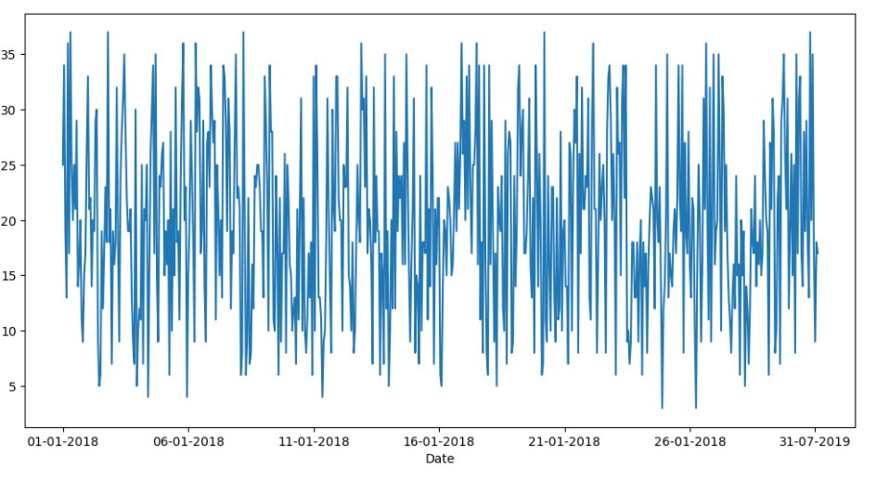
EDA cont..
Stable Variety with Seasonal Peaks
Most days show a steady flow of 10 to 25 unique products, indicating consistent diversity in daily shopping baskets.
Spikes nearing 30+ products suggest promotional campaigns, holidays, or restocking events driving broader basket composition.
Operational Consistency
There's no prolonged dip or outage in variety, which indicates strong supply chain consistency and steady customer engagement across the timeframe.
Trend Opportunity
Sharp one-day peaks could be mined to identify what drove the variety?

Slide 13
EDA SUMMARY [INFERENCES]
Dataset Overview:
Transactions: 20,641 rows across 603 unique dates
Orders: 1,139 unique Order IDs
Product Assortment: 37 distinct products spanning groceries, beverages, hygiene, and household items
Top-Selling Products
Poultry, Soda, Ice Cream, Toilet Paper, and Shampoo dominate unit sales—each surpassing 500 units
These are the core basket drivers and ideal anchor items for combo promotions
Product Penetration
Most products appear in 380–450 unique orders, indicating balanced, high-penetration inventory.
Histogram shows tight distribution with minimal deadweight—inventory strategy appears optimized
Daily product variety ranges from 10–30 items, showing consistent customer engagement
Peak sales day (08-Feb-2019) saw 183 units sold—an event/campaign worth replicating
Item-Level Transaction Patterns
Heatmap reveals frequent co-occurrence of pantry and hygiene items (e.g., Butter + Soap, Toilet Paper + Shampoo)
Clear signs of multi-category basket building behavior

Slide 14
MBA Starts
Process Overview: Association Rules in Context
1. Data Preparation
Cleaned transaction-level POS data containing Order ID and Product Name
Transformed into basket format where each row represents one transaction's itemset
Rule Mining Technique
Metrics used for evaluating rules: Support, Confidence, and Lift.
3. Association Rule Mining Parameters (KNIME)
Minimum Support: 0.05 → Only includes item combinations that appear in at least 5% of all transactions (i.e., sufficiently frequent to be business-relevant)
Minimum Confidence: 0.4 → Rules are retained only if there's at least a 40% chance that the consequent is purchased when the antecedent is present.
Maximal Itemset Length: 10 → Allows mining of both short and long rules to capture complex combinations
Underlying Structure: ARRAY, optimized for basket-format datasets
Transaction Column: Product_SplitResultSet, identifying items grouped per order

Slide 15
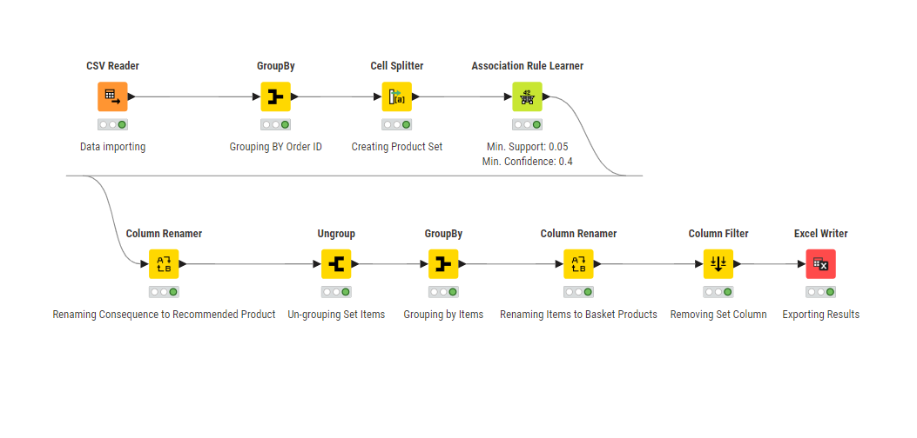
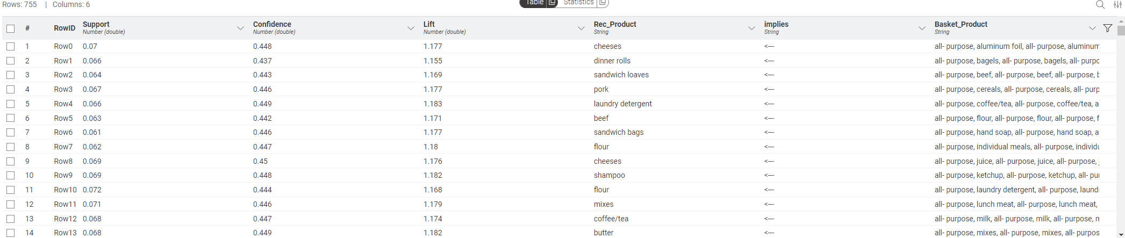
MBA (using KNIME)
KNIME Workflow:
Output table

Slide 16
MBA (using KNIME) Inferences
In-Depth Insights
1: Core Basket Drivers Involve Common Household Essentials: From your dataset, many of the frequently occurring items in the baskets include:
all-purpose cleaner
aluminum foil
coffee/tea
Cereals
bagels
beef
These products are essential or staple items that are frequently bought and likely form the base of shopping baskets. This suggests:
Customers tend to stock up on both food and non-food essentials in the same trip.
These staple items act as "basket anchors", influencing purchase of secondary items.
Implication: These items can be used as “hooks” to trigger upselling via paired promotions.
2: Cheeses, Pork, and Laundry Detergent Are High-Influence Association Targets:
The following items were frequently purchased alongside large baskets of mixed goods, with:
High confidence (~45%): Customers who purchase certain baskets have a ~45% chance of also purchasing these.
Lift > 1.17: Strong positive association beyond random chance.
Recommended Product | Average Confidence | Average Lift | Implication
Cheeses | 44.8% | 1.18 | Strong complementary item
Pork | 44.6% | 1.17 | High protein + grocery synergy
Laundry Detergent | 44.9% | 1.18 | Strong correlation between cleaning and grocery

Slide 17
MBA (using KNIME) Inferences
3: Certain Product Combinations Suggest Lifestyle or Meal Preferences: Some baskets hint at specific customer behaviors, for example:
All-purpose + Coffee/Tea → Laundry Detergent Suggests household restocking missions, not just food-based trips.
Beef + All-purpose → Sandwich Loaves Indicates prep for meals like sandwiches, implying convenience-oriented buying.
Bagels + All-purpose → Dinner Rolls Suggests customers interested in breakfast and bread-focused meals.
Implication: You can derive purchase intent (e.g., meal planning, household cleaning) from these rules and tailor time-based offers (e.g., weekend family packs).
Recommendations:
1. Launch Cross-Category Bundle Offers: Design cross-category promotions such as:
"Weekend Essentials Combo": All-purpose + Coffee/Tea + Laundry Detergent (Home care + Grocery)
"Protein + Bread Value Pack": Beef + Sandwich Loaves
"Morning Meal Bundle": Bagels + Dinner Rolls + Cheese
2. Optimize Store Layout and Product Placement
Use physical proximity in the store and UI proximity on e-commerce platforms:
Co-locate all-purpose cleaner and cheeses with signage like “Perfect Pairings for the Week.”
Place coffee/tea, aluminum foil, and detergents in a restock-oriented aisle zone.
Put bagels, sandwich loaves, and beef close together to encourage meal-focused shopping.

